Slide 1
Transport for London (TfL) Data Analysis
A Comprehensive Analysis of TfL Data Using Python, Tableau and Power BI

Slide 2
Introduction
This report presents a detailed analysis of the 2021 Annualised Entry and Exit dataset provided by TfL.

Slide 3
Table of contents
Data Cleaning & Preprocessing
Exploratory Data Analysis (EDA)
Advanced Data Analysis
Objective
Tools
Dashboard
Strategic Recommendations

Slide 4
Objectives
Clean and preprocess the raw TfL data to ensure data quality and consistency.
Uncover patterns and trends in station usage across London.
Identify operational hotspots and capacity stress points.
Evaluate the distribution of passenger traffic across the network.

Slide 5




Tools
Jupyter Notebook
Power BI
Tableau
Python

Slide 6
Data Cleaning & Preprocessing
Import Libraries and Load Data
Check for Missing Values
Check for Duplicates and Remove Them
Save the cleaned data
Data Transformation and Typing

Slide 7
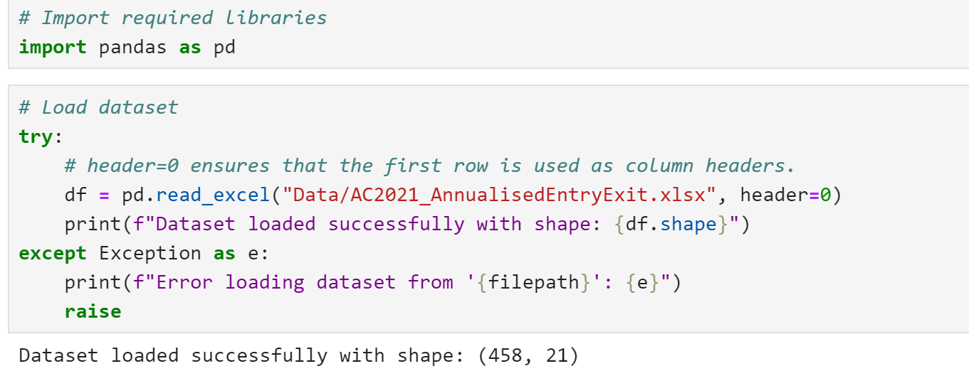
Import Libraries and Load Data
Import libraries such as Pandas, NumPy, and Matplotlib to facilitate data manipulation, numerical operations, and visualization respectively. Load the TfL dataset using Pandas' read_excel function to create a DataFrame for analysis.

Slide 8
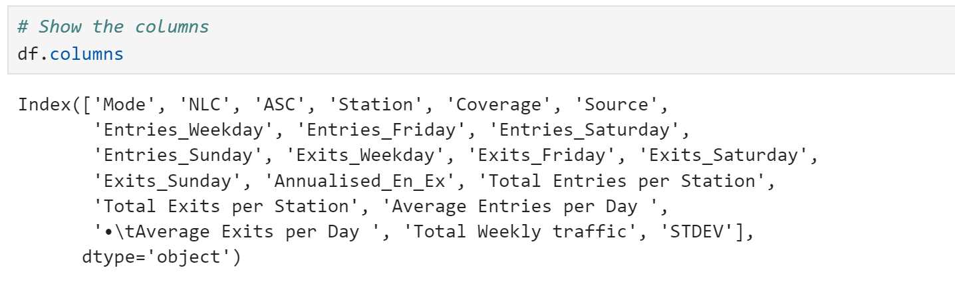
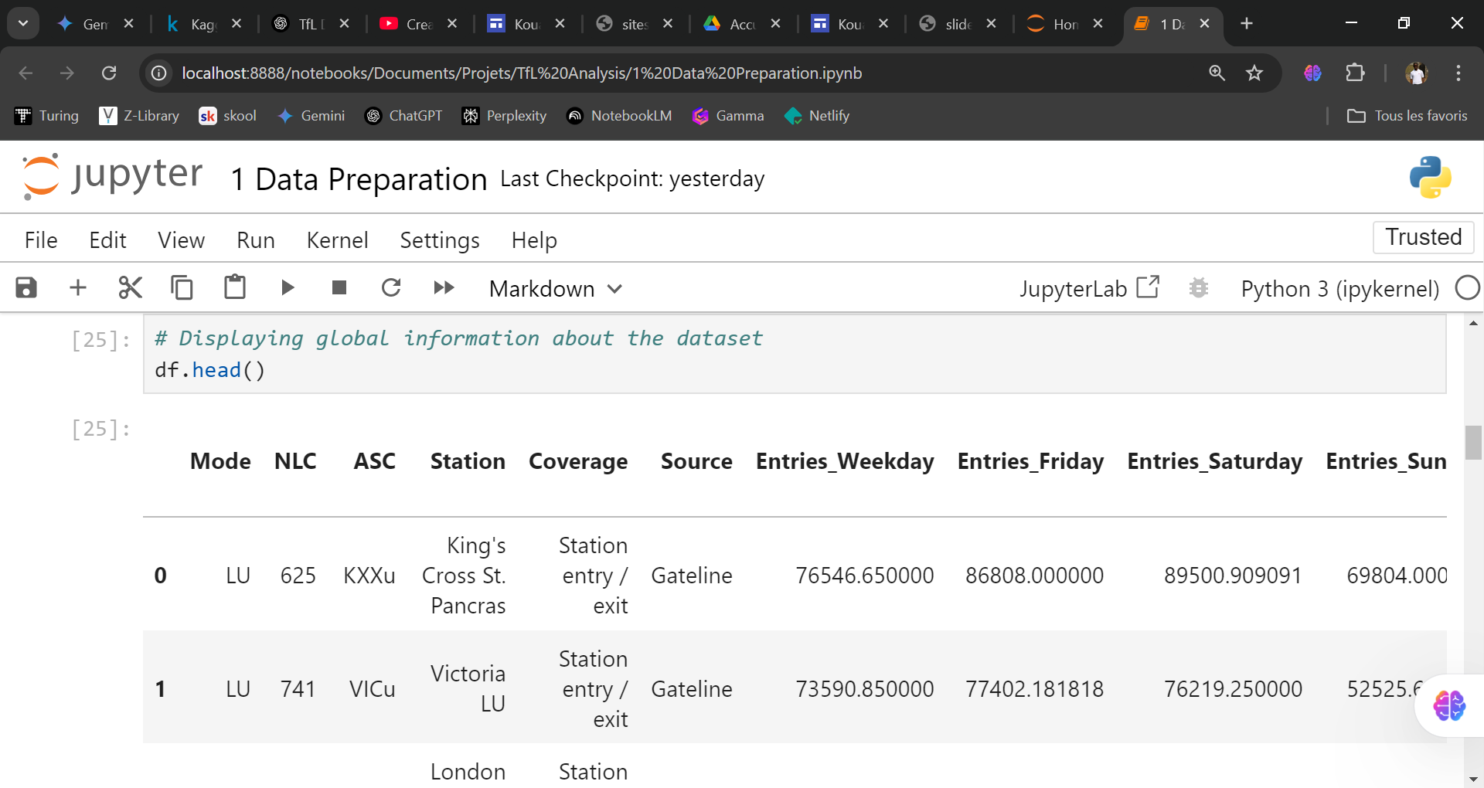

Slide 9
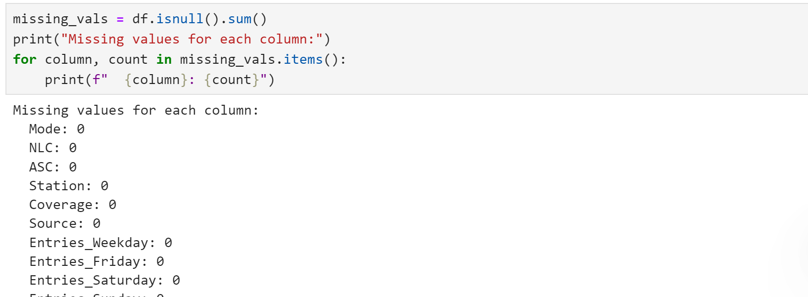
Check for Missing Values
Check for missing values in the dataset by using functions like isnull() in Pandas, which returns a boolean DataFrame indicating the presence of missing values. Summarize the total count of missing values for each column to identify which variables need attention for data cleaning.

Slide 10
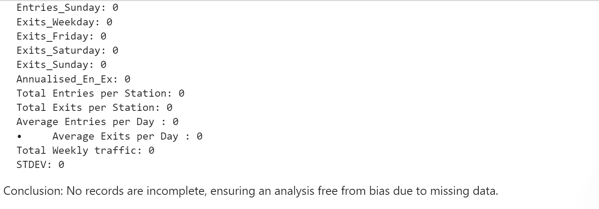
Check for Missing Values

Slide 11
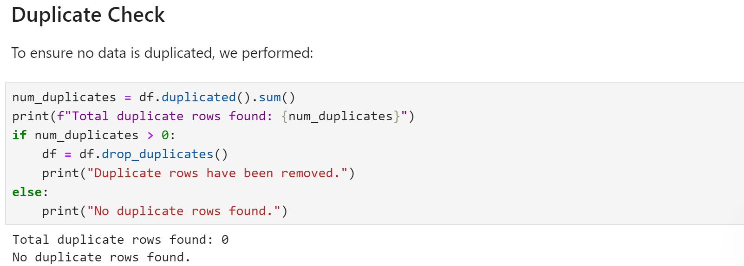
Check for Duplicates and Remove Them
Check for duplicates in the dataset using the duplicated() function in Pandas, which identifies any rows that are exact copies of others. To ensure data integrity, remove these duplicate entries by applying the drop_duplicates() function, keeping only unique records necessary for accurate analysis.

Slide 12
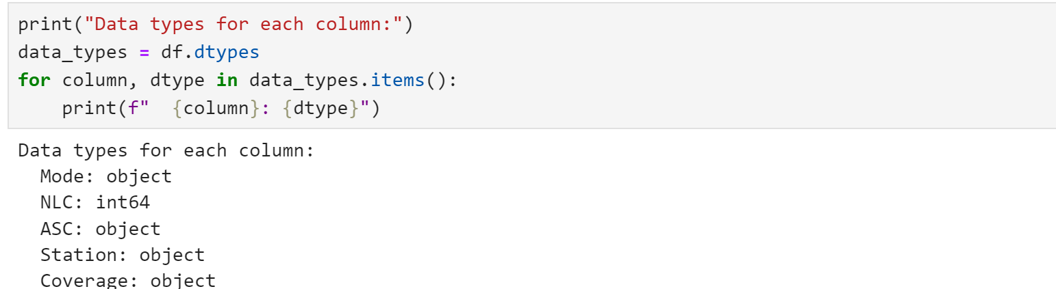
Data Transformation and Typing
Verify if the type of the field correspond to the data. Transform data by applying some manipulation techniques to ensure uniformity in data representation.

Slide 13
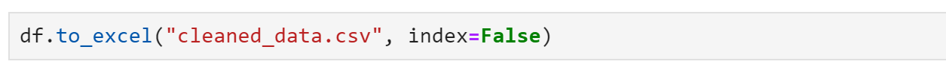
Save the cleaned data
Save the cleaned data by using the to_excel() function in Pandas, specifying the desired file path and name. Ensure to set parameters like index=False to avoid saving the DataFrame index as a separate column. This step allows for easy retrieval and use of the cleaned dataset for future analysis or reporting.

Slide 14
Exploratory Data Analysis (EDA)
Station and Mode Analysis
Stations and Their Characteristics:
Transport Modes:
Daily and Weekly Variations:
Seasonal and Peak Times
Traffic Patterns and Temporal Analysis

Slide 15
A - Station and Mode Analysis
1 - Stations and Their Characteristics:
Questions to answer :
How many unique stations are present in the data?
Which stations report the highest volumes of entries and exits (both total and per y)?
Is there a correlation between station coverage (as indicated by the `Coverage` column) and the volume of traffic?

Slide 16
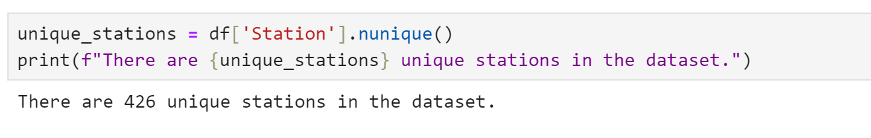
a - Unique Stations
Determine how many unique stations are present in the dataset.

Slide 17
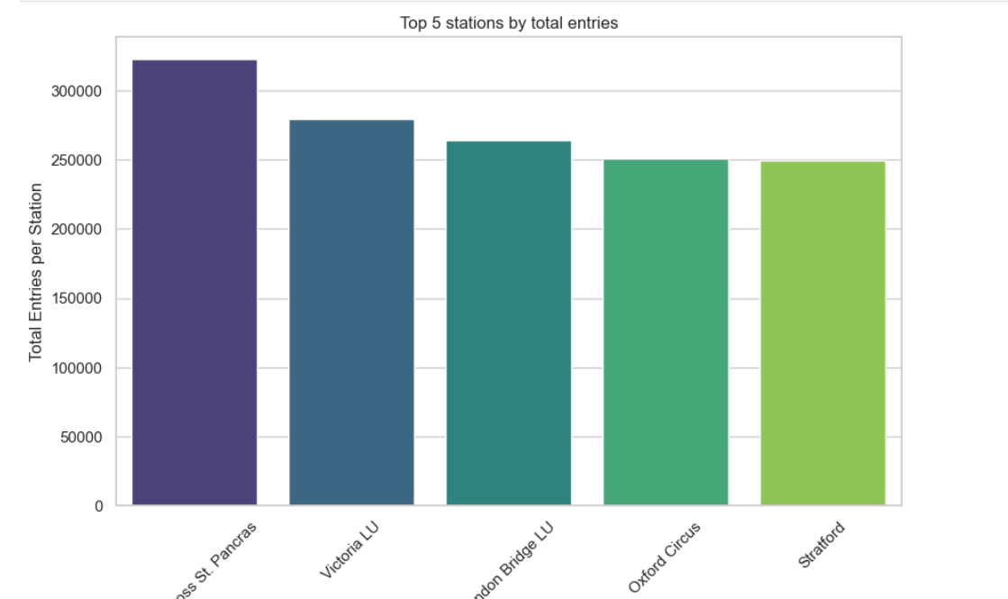
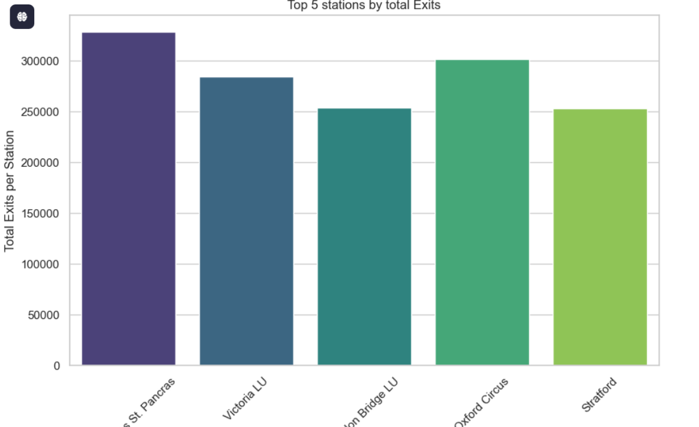
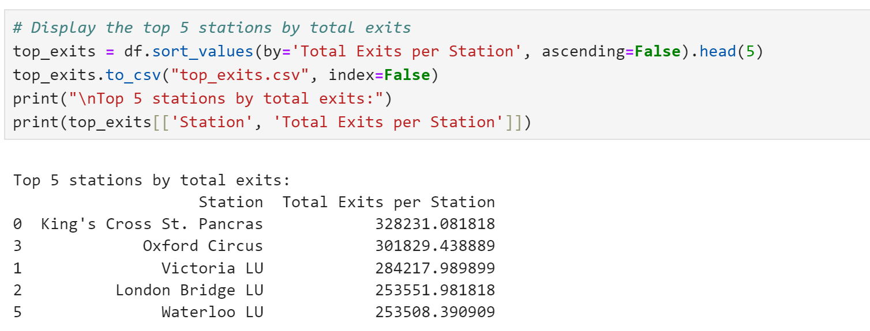
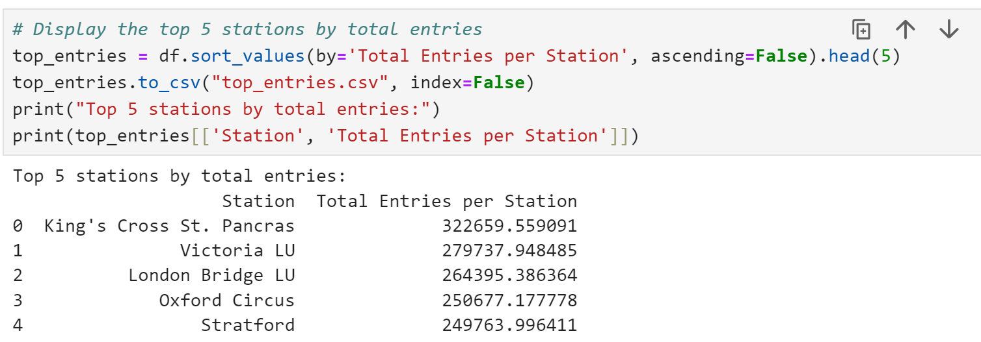
b - Stations with Highest Volumes of Entries and Exits
We wish to identify:
The stations with the highest total entries (`Total Entries per Station`)
The stations with the highest total exits (`Total Exits per Station`)

Slide 18
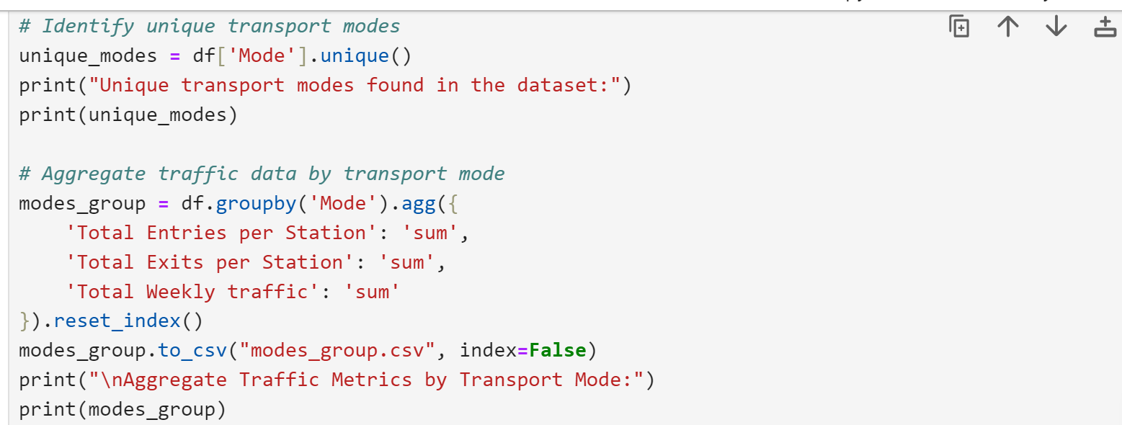
2 - Transport Modes Analysis
We answer:
What are the unique transport modes?
How does passenger traffic vary by mode (aggregating total entries and exits)?
Is one transport mode significantly busier than the others?

Slide 19
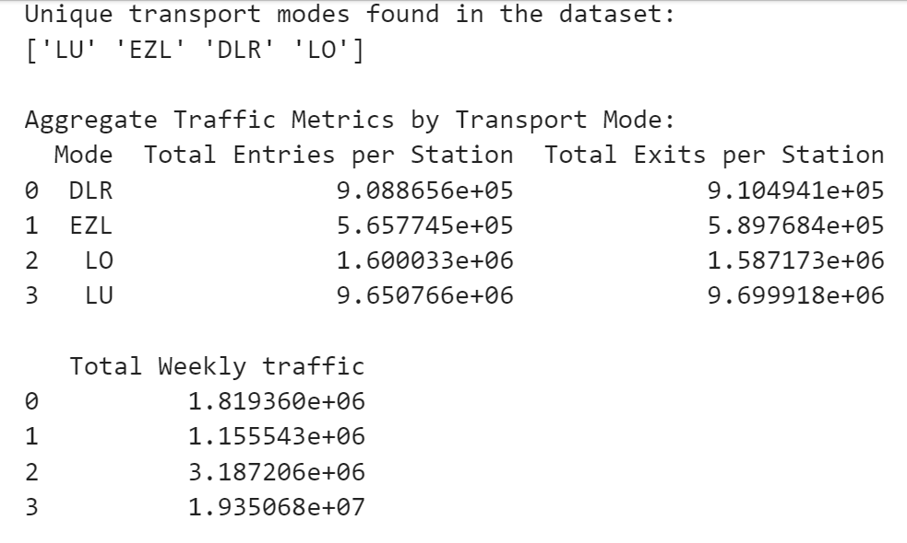
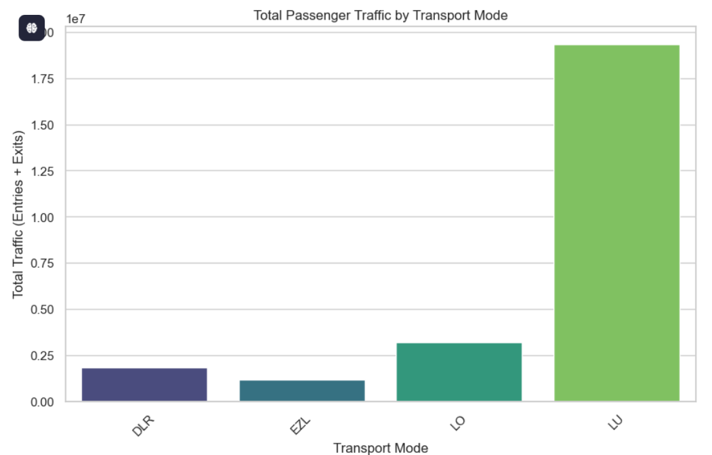

Slide 20
B - Traffic Patterns and Temporal Analysis
1 - Daily and Weekly Variations:
How do passenger entries and exits vary between weekdays, Fridays, Saturdays, and Sundays?
Are there significant differences in average daily traffic (as per `Average Entries per Day ` and `Average Exits per Day`) compared to total weekly traffic?

Slide 21
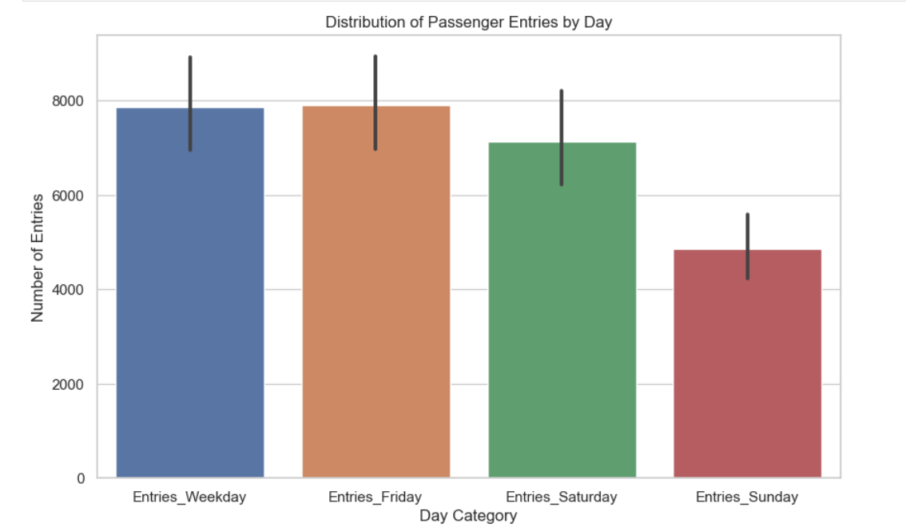
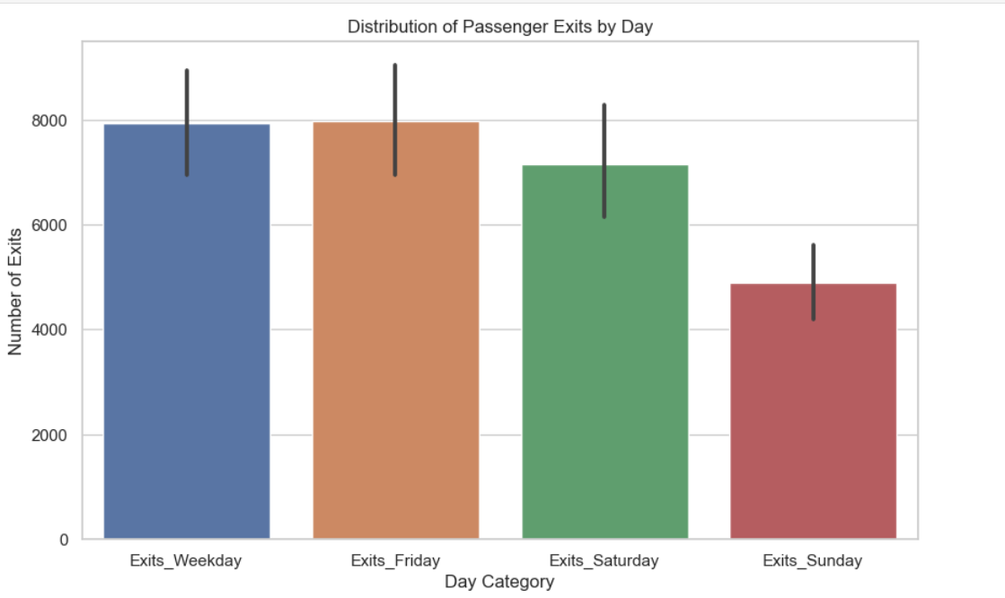
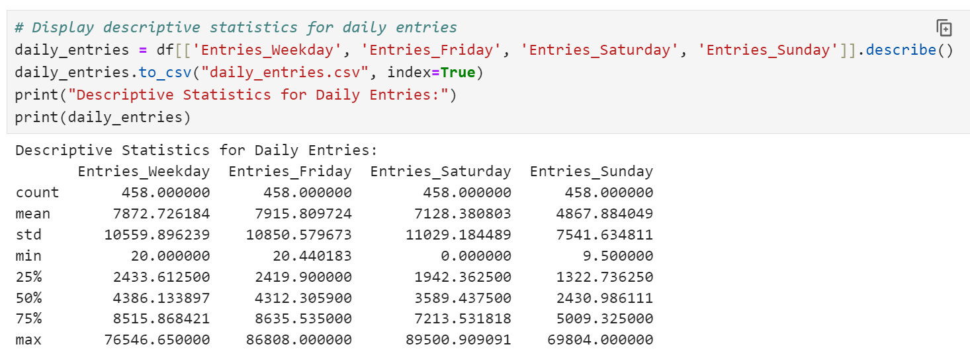
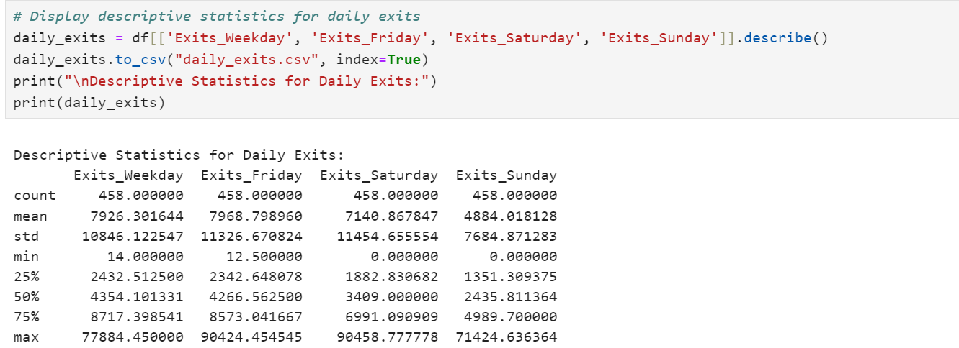
a - Daily Variations in Passenger Traffic
We will generate descriptive statistics and visualisations (boxplots) to compare distributions.

Slide 22
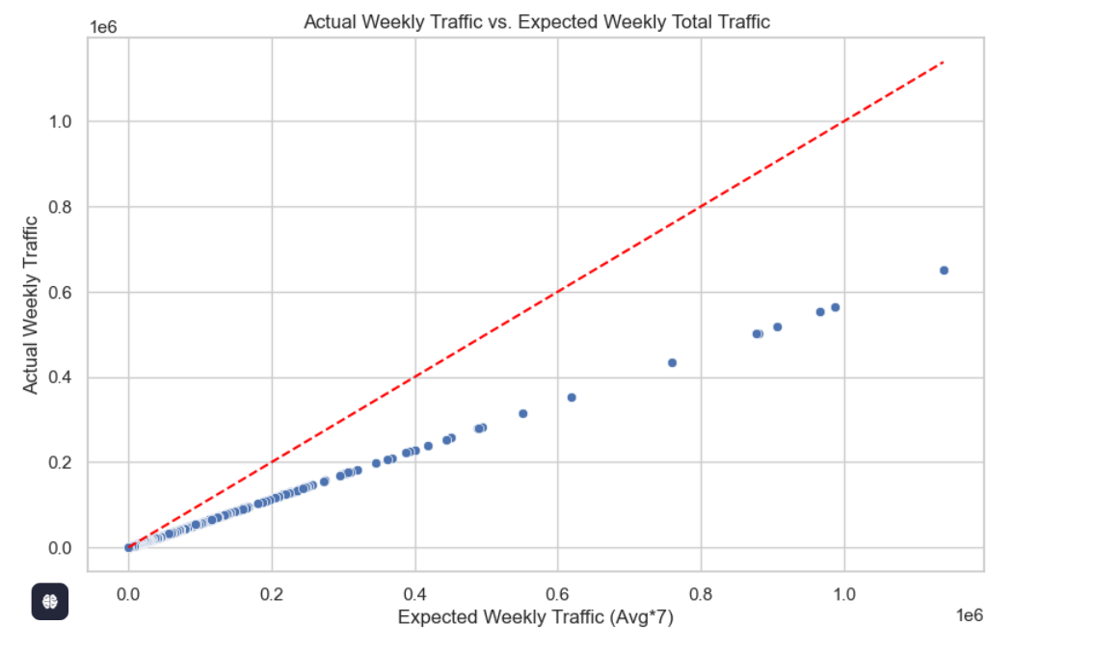
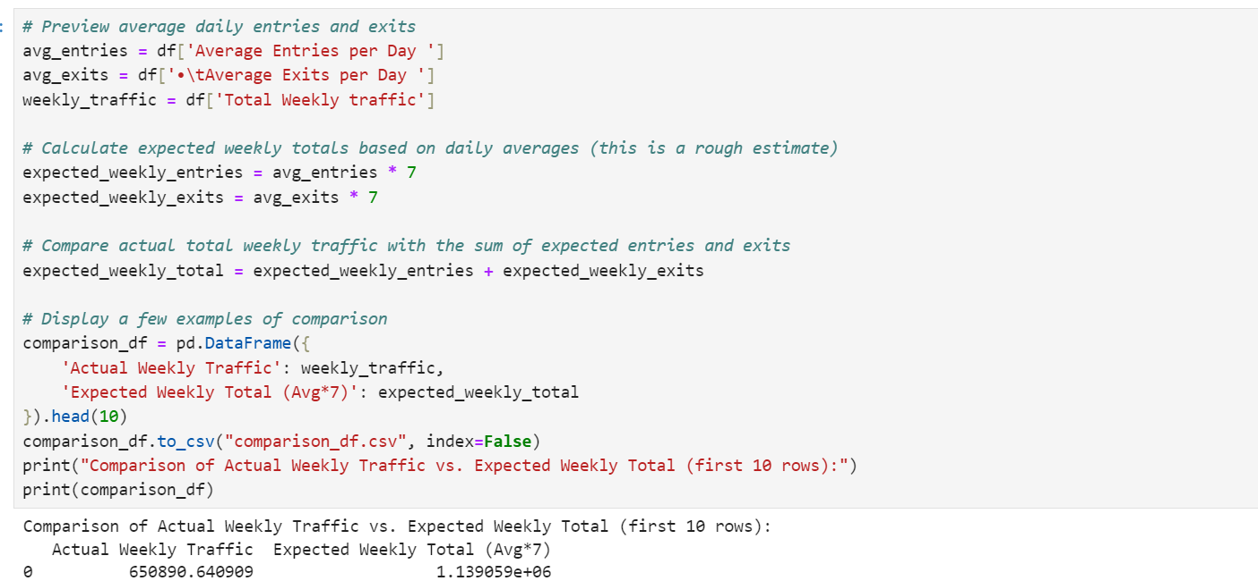
b - Average Daily Traffic vs. Total Weekly Traffic
We compare the average daily values from `Average Entries per Day ` and `Average Exits per Day `Against `Total Weekly traffic`
Notes:
We calculate expected weekly totals (average * 7, though note that days might not be uniform) and compare with the actual totals.

Slide 23
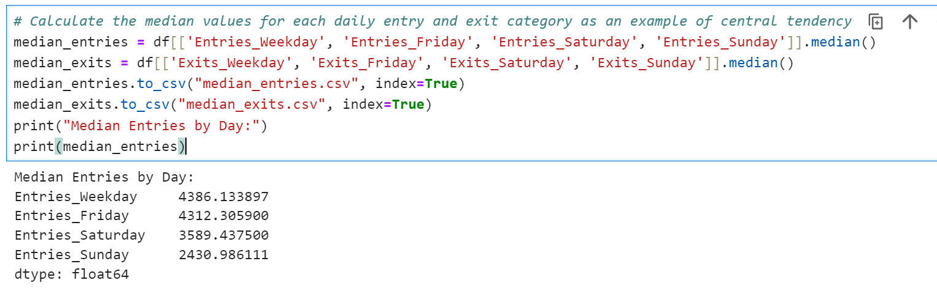
2 - Analysis of Seasonal and Peak Times: Identifying Exceptional Days
We compare specific days (particularly Fridays versus weekends) to see if any days consistently show higher or lower traffic. Additionally, we explore the relationship between the standard deviation (`STDEV`) and overall traffic variability.

Slide 24
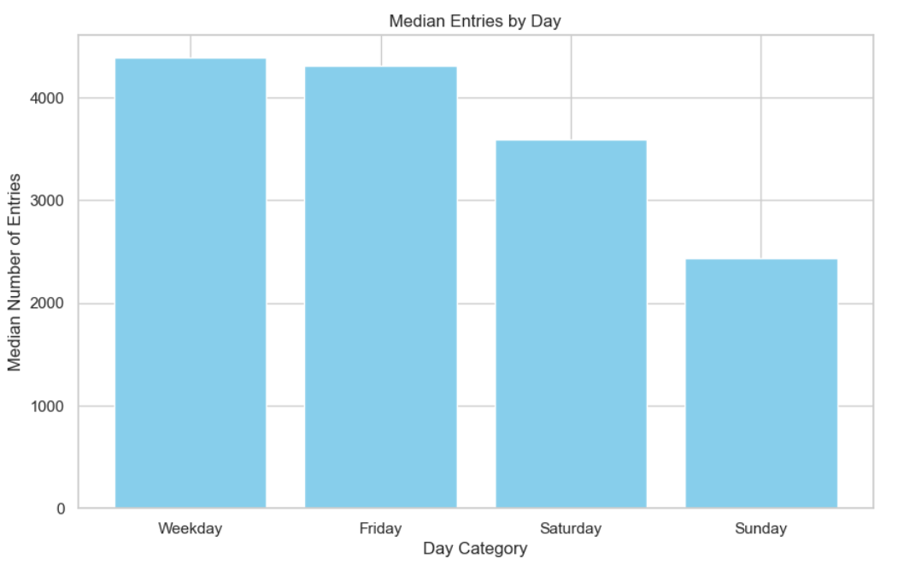
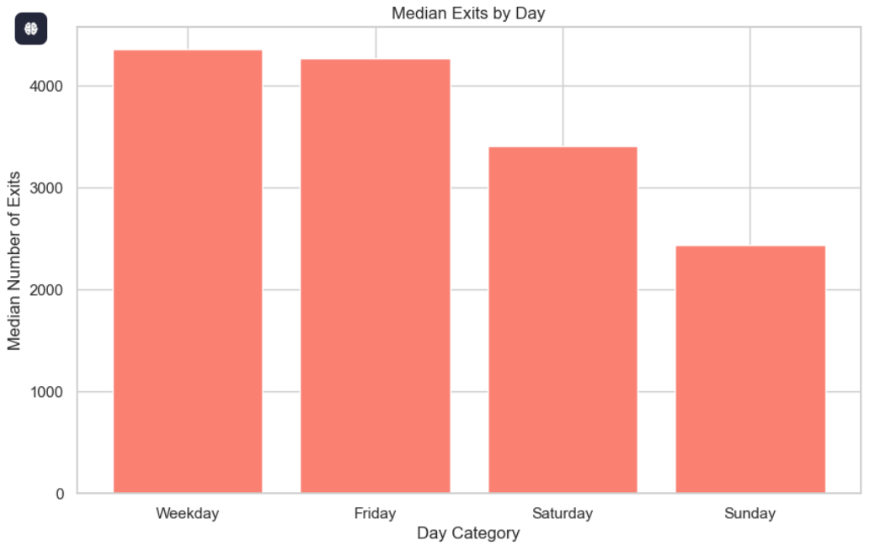

Slide 25
Advanced Data Analysis
Inter-relationships and Correlations
Contextual and Operational Insights

Slide 26
A - Inter-relationships and Correlations Analysis
Here, we explores:
The correlation between ‘Total Entries per Station’ and ‘Total Exits per Station’.
The relationship between ‘Annualised_En_Ex’ and daily/weekly traffic figures.
The association between the data source (‘Source’) and classification fields (‘NLC’, ‘ASC’) with traffic volumes.

Slide 27
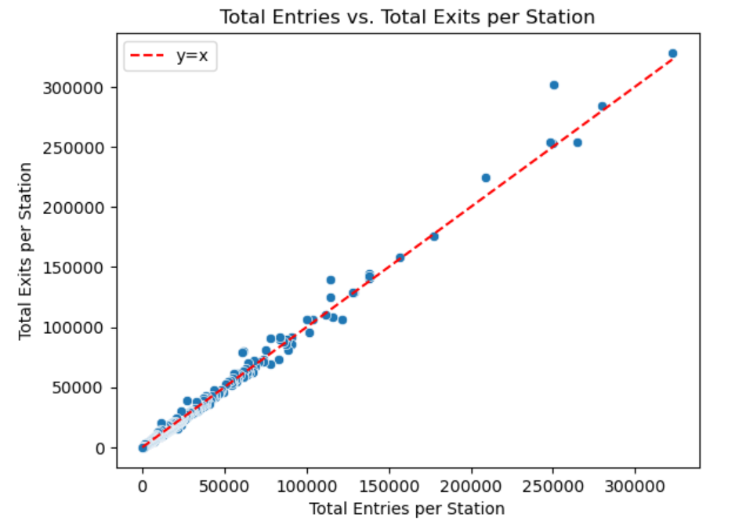
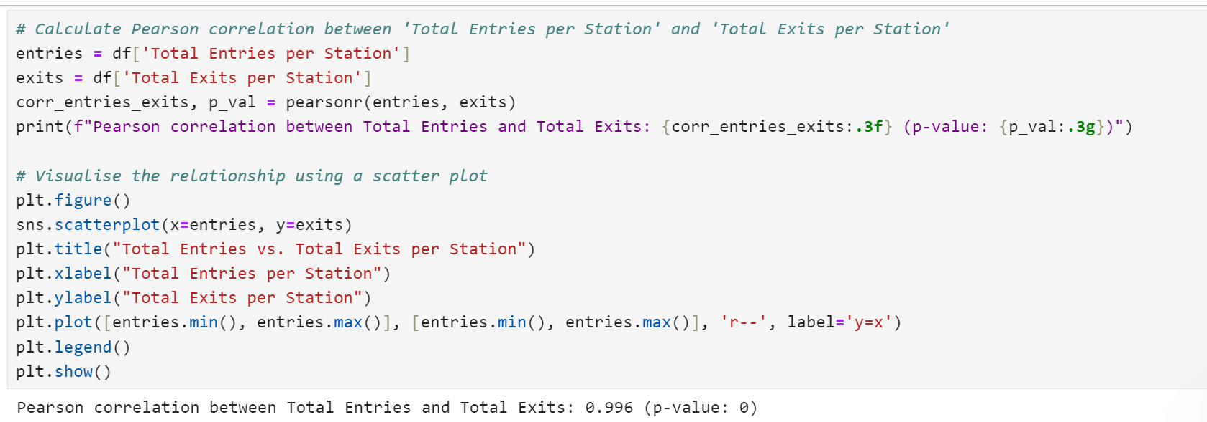
1 - Correlation between Total Entries and Total Exits per Station
This section evaluates whether there is a strong correlation between the total entries and exits reported for each station.

Slide 28
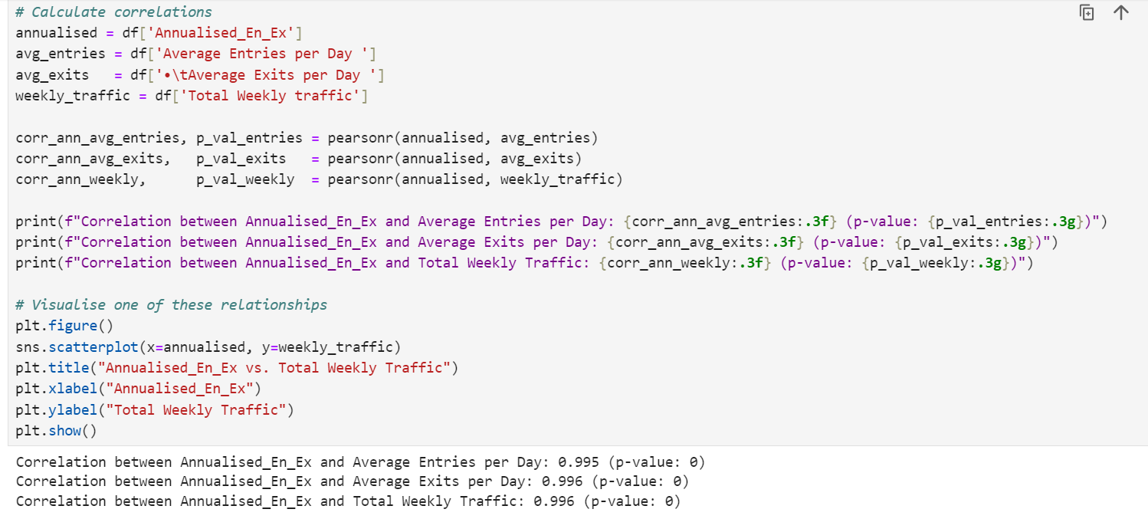
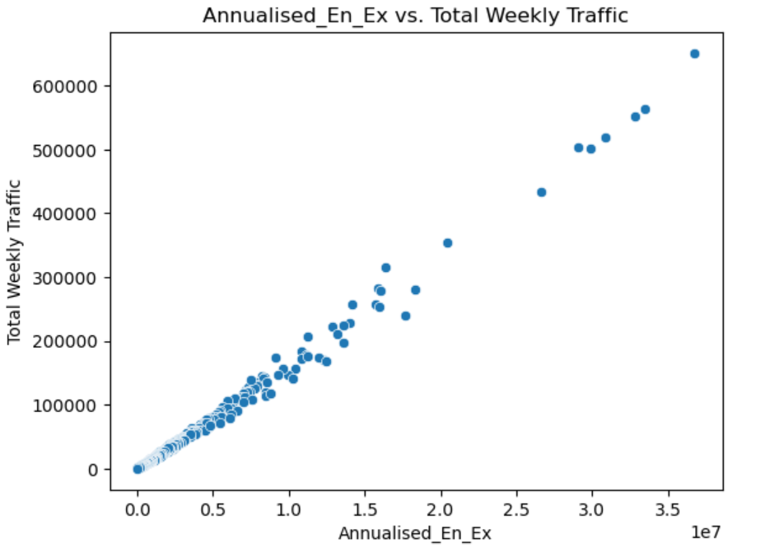
2 - Correlation of Annualised_En_Ex with Daily and Weekly Traffic Figures
This section examines how the ‘Annualised_En_Ex’ (annualised entries and exits) column correlates with ‘Average daily traffic’ (using columns such as `Average Entries per Day ` and `Average Exits per Day `) and Total weekly traffic

Slide 29
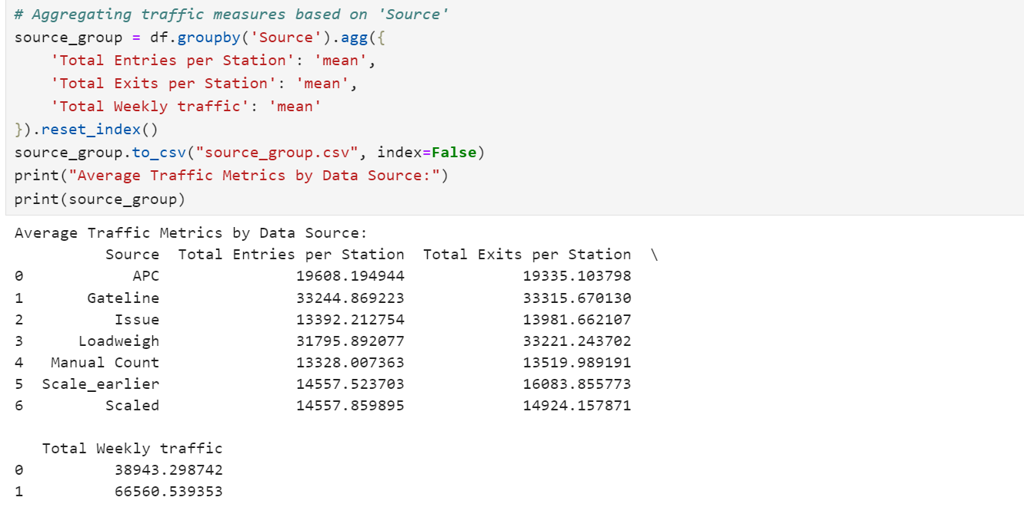
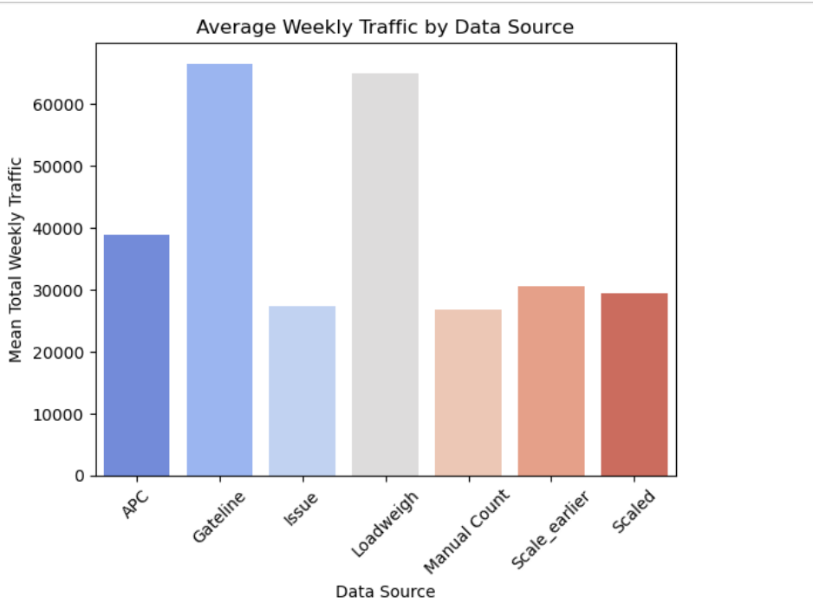
3 - Relationship between Data Source/Classifications and Traffic Volumes
Here, we investigate if the ‘Source’ fields have any impact on traffic volumes..
Notes:
We achieve this by grouping the data and comparing average traffic measures across the groups

Slide 30
B - Contextual and Operational Analysis
This section explores:
Operational Impact: How variations in transport mode usage and the distribution of entries/exits (across days or during special events) can help inform service planning and capacity allocation.
Data Source Reliability: Investigating differences in reporting or data quality across different sources and coverage areas, and assessing if the observed traffic values match expected patterns. Each code section aggregates relevant data, creates visualisations, and prints statistical summaries to support actionable insights.

Slide 31
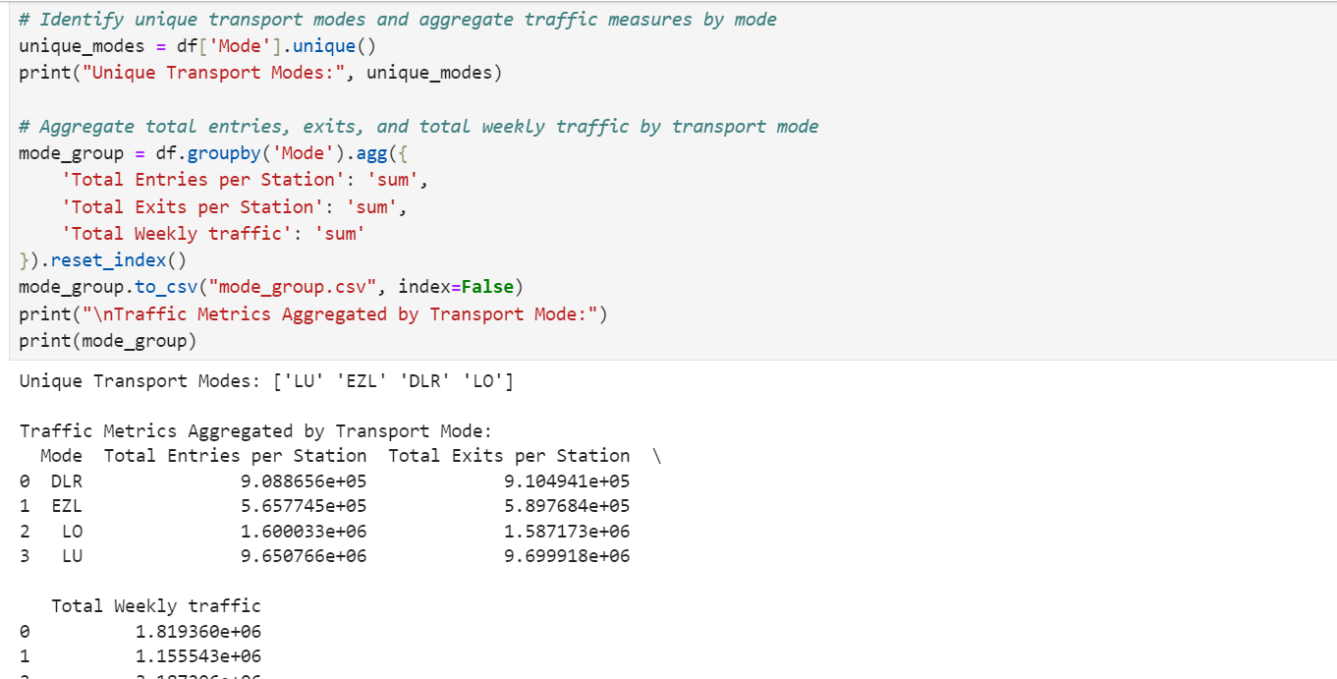
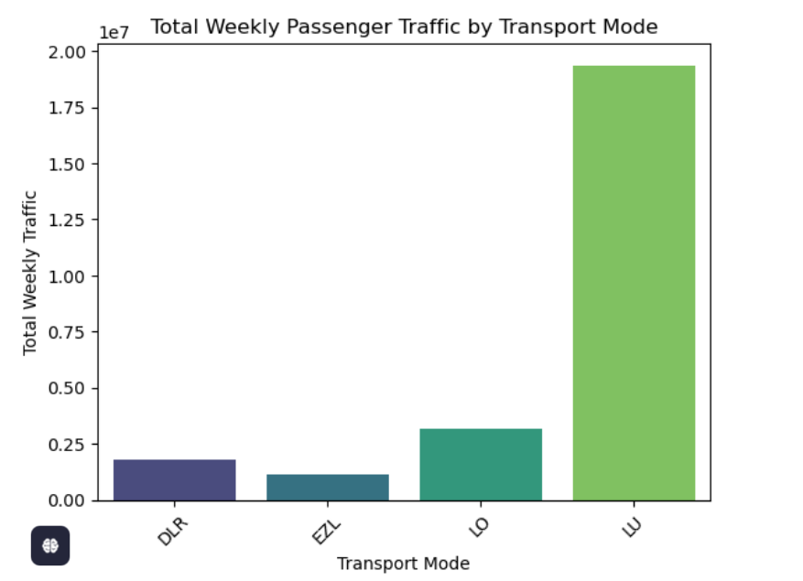
1 - Operational Impact Analysis
a - Variations in Transport Mode Usage
We explore how different transport modes compare in terms of total passenger traffic
Notes:
. This information is crucial for service planning (e.g. more capacity may be needed for the busier modes). If one mode is handling significantly more passengers than others, resource allocation (e.g. additional trains, staffing, maintenance schedules) can be adjusted accordingly.

Slide 32
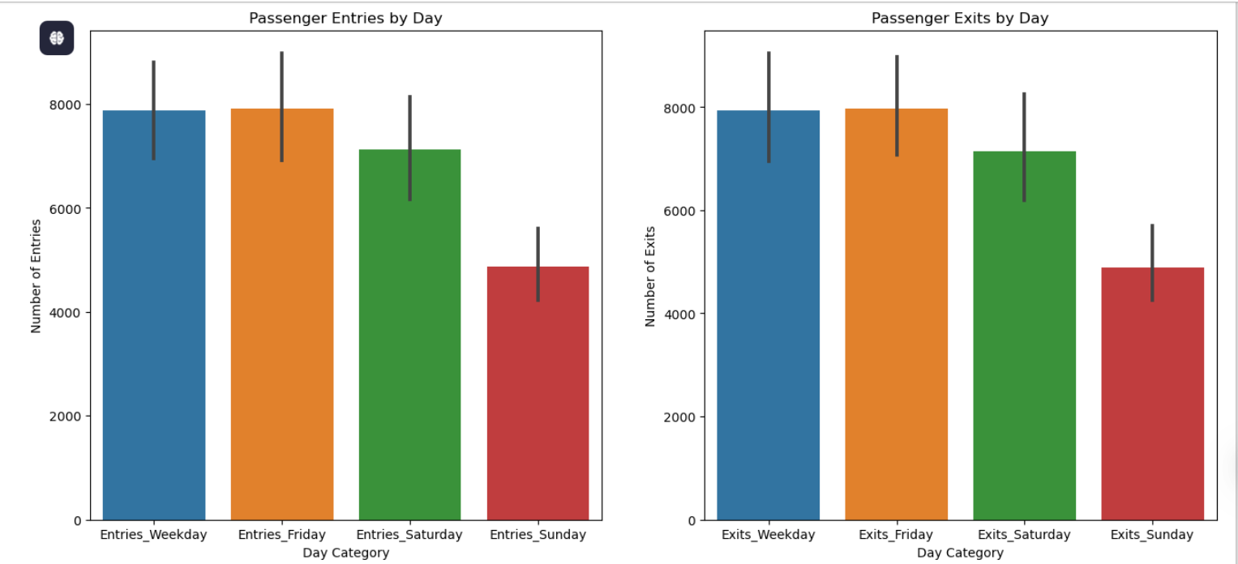
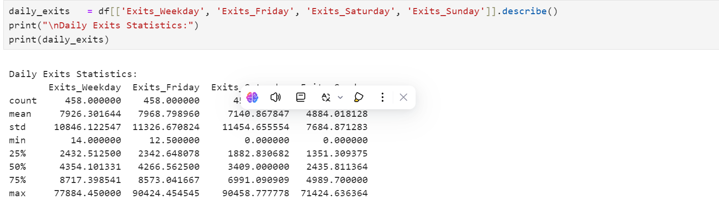
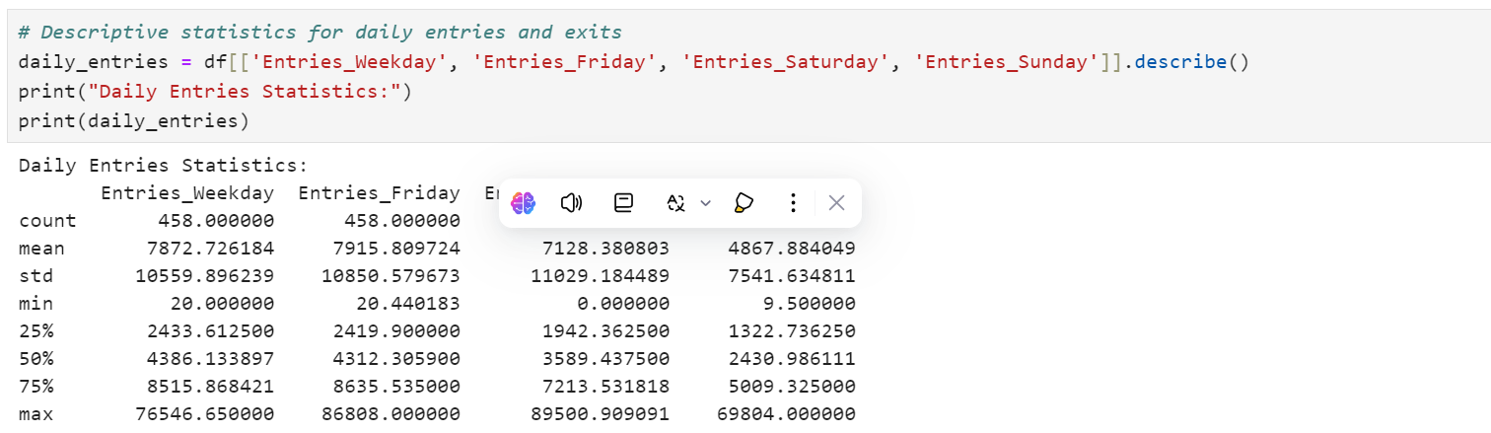
b - Distribution of Entries and Exits Across Days
Here we compare the variability of passenger entries and exits between weekdays, Fridays, Saturdays, and Sundays.
Notes:
This analysis can reveal:- Peak days (e.g. if weeddays consistently show higher traffic, or weekends reflect lower usage).- Impact of events such as strikes or public holidays.By understanding which days experience unusual surges or drops, scheduling, and resource allocation can be optimised.

Slide 33
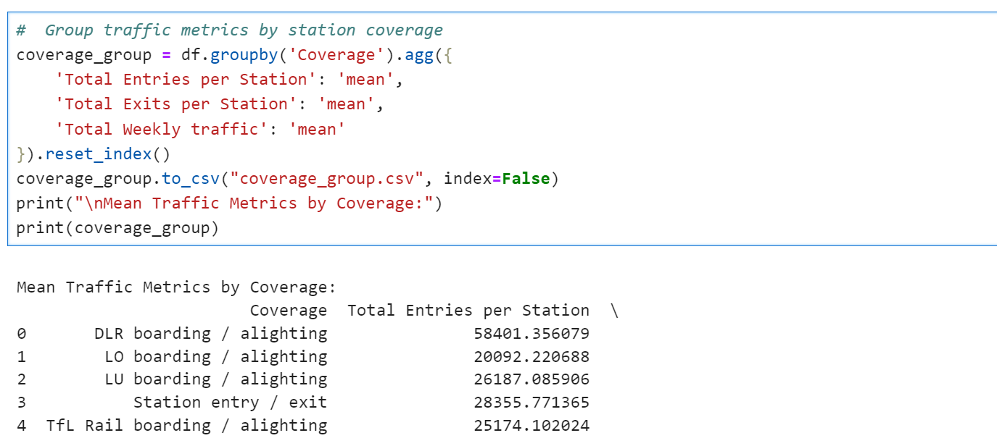
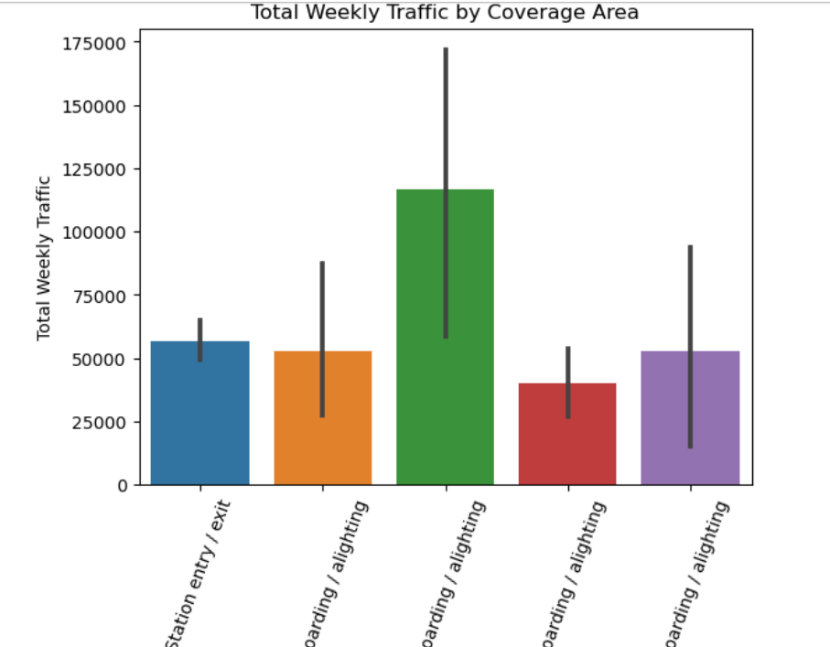
2 - Station coverage Reliability
In this section, we examine variations in reporting and data quality Grouping by station coverage.
Notes:
can help identify any discrepancies or inconsistencies.

Slide 34
Dashboard

Slide 35
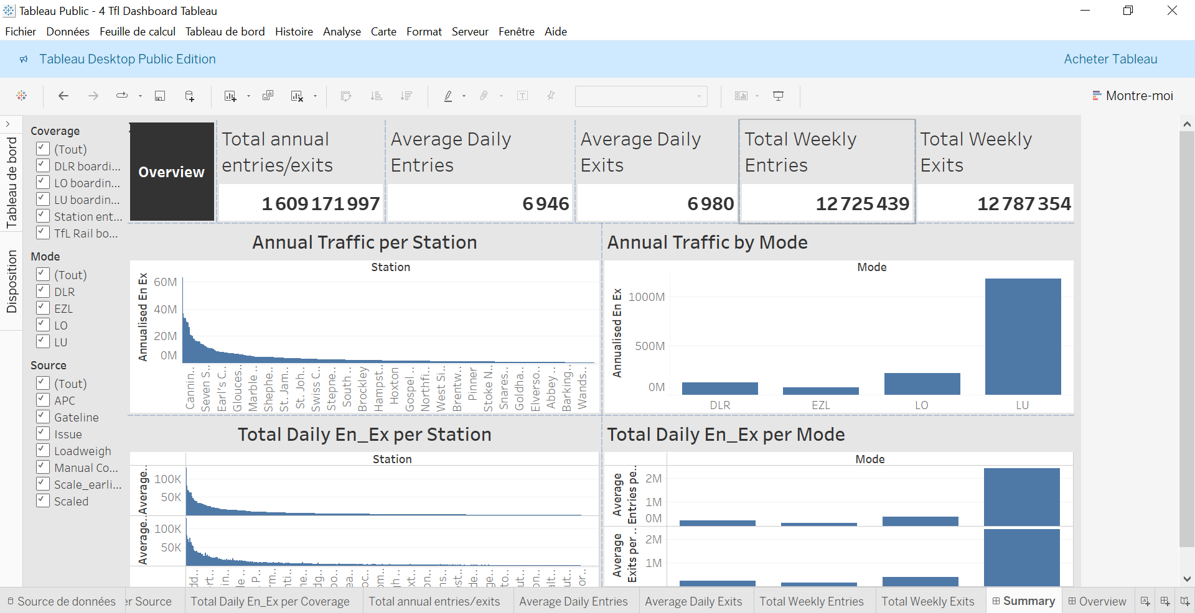
Dashboard

Slide 36
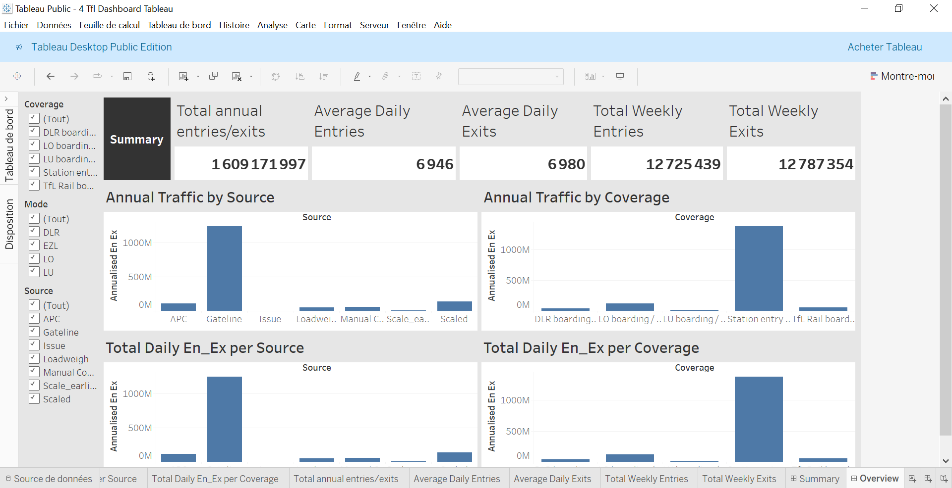
Dashboard

Slide 37
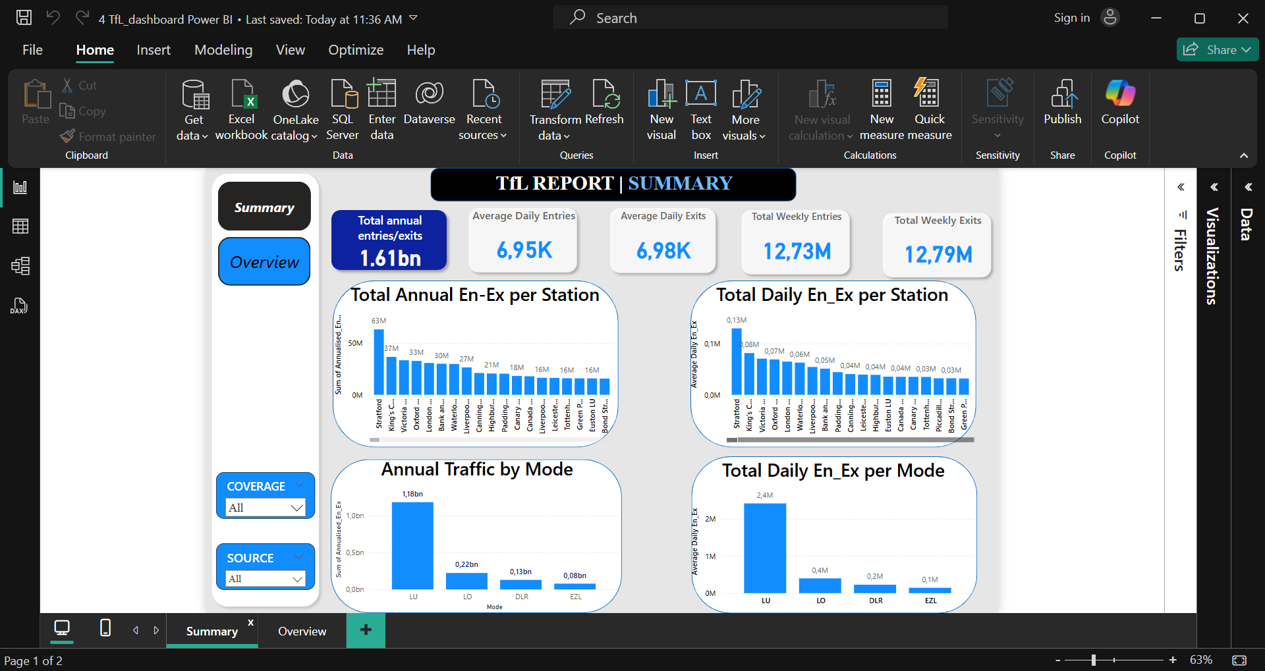
Dashboard

Slide 38
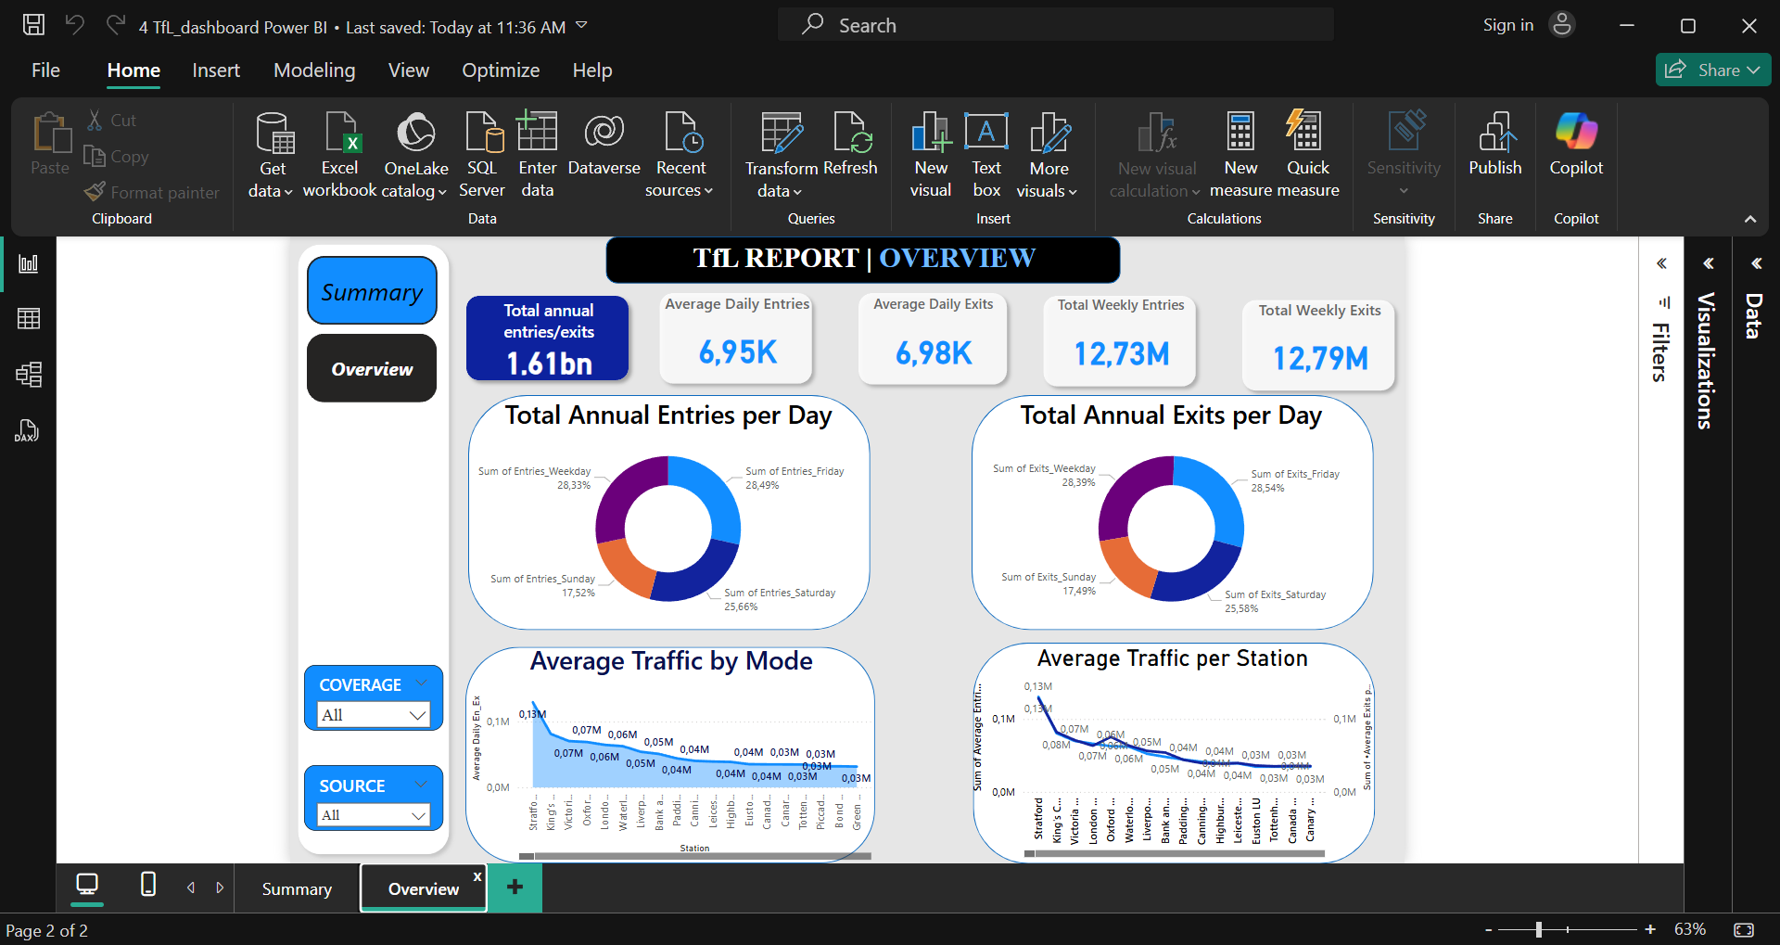

Slide 39
Strategic Recommendations
1. Optimize Capacity at High-Traffic Stations
Action: Prioritize infrastructure enhancements at stations with consistently high passenger volumes, such as Oxford Circus, Waterloo, and King's Cross St. Pancras.
Rationale: These stations exhibit the highest total and daily entries and exits, indicating potential congestion and the need for capacity improvements.
2. Implement Dynamic Service Scheduling
Action: Adjust service frequencies based on daily and weekly traffic patterns, increasing services during peak times (e.g., Fridays) and reducing during lower demand periods (e.g., weekends)
Rationale: Traffic volumes are generally higher on weekdays, peaking on Fridays before declining over weekends. Aligning services with these patterns can improve efficiency and passenger satisfaction

Slide 40
Strategic Recommendations
3. Enhance Data Quality and Standardization
Action: Standardize data collection and reporting methods across all sources and coverage areas to ensure consistency and reliability
Rationale: Variations in data quality across different sources and coverage areas were noted. Standardization will improve the accuracy of analyses and decision-making processes
4. Leverage Predictive Analytics for Demand Forecasting
Action: Utilise advanced analytics and machine learning models to predict passenger demand and identify potential anomalies or outliers in traffic patterns
Rationale: Stations with unusually high standard deviations in traffic (STDEV) were identified, indicating significant fluctuations in passenger numbers. Predictive analytics can help in proactively managing such variations

Slide 41
Strategic Recommendations
5. Promote Multi-Modal Integration
Action: Encourage seamless integration between different transport modes (e.g., Tube, Overground, DLR) to distribute passenger loads more evenly across the network
Rationale: The Tube consistently records the highest passenger traffic, while other modes show more localized and lower-volume patterns. Better integration can alleviate congestion on the Tube and optimize the use of other modes
6. Monitor and Address Operational Anomalies
Action: Establish a monitoring system to detect and investigate stations or modes with unusually high traffic fluctuations, determining whether they result from data entry issues or genuine operational anomalies
Rationale: Identifying and addressing the root causes of these anomalies will enhance operational reliability and passenger experience

Slide 42
Strategic Recommendations
7. Invest in Infrastructure Upgrades
Action: Allocate resources for the expansion and modernization of infrastructure at stations identified as high-traffic or experiencing significant growth
Rationale: Proactive infrastructure investments will accommodate increasing passenger volumes and improve overall network resilience
8. Enhance Real-Time Passenger Information Systems
Action: Improve real-time information dissemination to passengers regarding service changes, delays, and alternative routes, especially during peak times and special events
Rationale: Effective communication can mitigate the impact of service disruptions and enhance passenger satisfaction

Slide 43
Conclusion
This presentation has shown key trends in Tfl data. These findings are crucial for informed Station planning and resource allocation.

Slide 44
Thank you!

